Slide 1
UNIT II XML Tutorial

Slide 2
What is XML?
XML stands for EXtensible Markup Language
XML is a markup language much like HTML
XML was designed to carry data, not to display data
XML tags are not predefined. You must define your own tags
XML is designed to be self-descriptive
XML is a W3C Recommendation

Slide 3
The Difference Between XML and HTML
XML is not a replacement for HTML.
XML and HTML were designed with different goals:
XML was designed to transport and store data, with focus on what data is
HTML was designed to display data, with focus on how data looks
HTML is about displaying information, while XML is about carrying information.

Slide 4
What XML does?
XML was created to structure, store, and transport information.
The following example is a note to Tove, from Jani, stored as XML:
<note> <to>Tove</to> <from>Jani</from> <heading>Reminder</heading> <body>Don't forget me this weekend!</body> </note>

Slide 5
How can XML be used?
XML Separates Data from HTML
XML Simplifies Data Sharing (database)
XML Simplifies Data Transport (incompatible systems)
XML Simplifies Platform Changes (upgrading h/w or s/w)
XML Makes Your Data More Available ((Handheld computers, voice machines, news feeds, etc.))
XML is Used to Create New Internet Languages

Slide 6
Example XML file
<?xml version="1.0" encoding="UTF-8"?> --XML declaration <note> --- root element <to>Tove</to> -- child element <from>Jani</from> -- child element <heading>Reminder</heading> -- child element <body>Don't forget me this weekend!</body> -- child element </note>

Slide 7
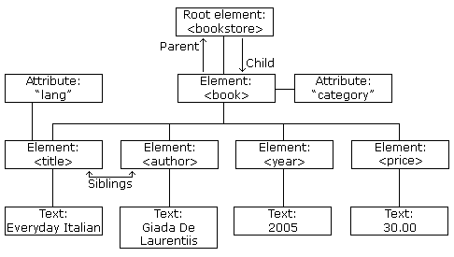
Example

Slide 8
<bookstore> <book category="COOKING"> <title lang="en">Everyday Italian</title> <author>Giada De Laurentiis</author> <year>2005</year> <price>30.00</price> </book>
<book category="CHILDREN"> <title lang="en">Harry Potter</title> <author>J K. Rowling</author> <year>2005</year> <price>29.99</price> </book>
<book category="WEB"> <title lang="en">Learning XML</title> <author>Erik T. Ray</author> <year>2003</year> <price>39.95</price> </book> </bookstore>

Slide 9
Well-Formed XML document
Refer ex0.xml
All XML Elements Must Have a Closing Tag
XML Tags are Case Sensitive
XML Elements Must be Properly Nested
XML Documents Must Have a Root Element
XML Attribute Values Must be Quoted
Entity References

Slide 10
Entity references
Entity References
Some characters have a special meaning in XML.
If you place a character like "<" inside an XML element, it will generate an error because the parser interprets it as the start of a new element.
This will generate an XML error:
<message>if salary < 1000 then</message>
To avoid this error, replace the "<" character with an entity reference:
<message>if salary &lt; 1000 then</message>

Slide 11
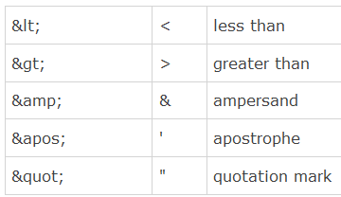
Entity references
There are 5 predefined entity references in XML:

Slide 12
Comments in XML
<!-- This is a comment -->
White space is preserved in XML

Slide 13
What is an XML Element?
An XML element is everything from (including) the element's start tag to (including) the element's end tag.
An element can contain:
other elements
text
attributes
or a mix of all of the above...

Slide 14
Element naming rules
XML elements must follow these naming rules:
Names can contain letters, numbers, and other characters
Names cannot start with a number or punctuation character
Names cannot contain spaces
Any name can be used, no words are reserved.

Slide 15
Attributes
Attributes provide additional information about an element.
Attribute values must always be quoted. Either single or double quotes can be used.
If the attribute value itself contains double quotes you can use single quotes, like in this example:
<gangster name=‘Ben "Shotgun" Ziegler'>
or you can use character entities:
<gangster name=“Ben &quot;Shotgun&quot; Ziegler">

Slide 16
XML elements Vs Attributes
<person gender="female"> <firstname>Anna</firstname> <lastname>Smith</lastname> </person>
(OR) <person> <gender>female</gender> <firstname>Anna</firstname> <lastname>Smith</lastname> </person>

Slide 17
Best practice
<note date="10/01/2008"> <to>Tove</to> <from>Jani</from> <heading>Reminder</heading> <body>Don't forget me this weekend!</body> </note>

Slide 18
Best practice
<note> <date>10/01/2008</date> <to>Tove</to> <from>Jani</from> <heading>Reminder</heading> <body>Don't forget me this weekend!</body> </note>

Slide 19
Best practice
<note> <date> <day>10</day> <month>01</month> <year>2008</year> </date> <to>Tove</to> <from>Jani</from> <heading>Reminder</heading> <body>Don't forget me this weekend!</body> </note>

Slide 20
Why best practice?
Some of the problems with using attributes are:
attributes cannot contain multiple values (elements can)
attributes cannot contain tree structures (elements can)
attributes are not easily expandable (for future changes)
Attributes are difficult to read and maintain.

Slide 21
Don’t end up like this
<note day="10" month="01" year="2008" to="Tove" from="Jani" heading="Reminder" body="Don't forget me this weekend!"> </note>

Slide 22
XML Attributes as ID references
<messages> <note id="501"> <to>Tove</to> <from>Jani</from> <heading>Reminder</heading> <body>Don't forget me this weekend!</body> </note> <note id="502"> <to>Jani</to> <from>Tove</from> <heading>Re: Reminder</heading> <body>I will not</body> </note> </messages>

Slide 23
XML Encoding
XML documents can contain international characters, like Norwegian æøå, or French êèé.
To avoid errors, you should specify the encoding used, or save your XML files as UTF-8.

Slide 24
Character Encoding
Character encoding defines a unique binary code for each different character used in a document.
In computer terms, character encoding are also called character set, character map, code set, and code page.

Slide 25
Unicode
Unicode is an industry standard for character encoding of text documents. It deﬁnes (nearly) every possible international character by a name and a number.
Unicode has two variants: UTF-8 and UTF-16.
UTF = Universal character set Transformation Format.
UTF-8 uses a single byte (8-bits) to represent commonly used characters and two (or three) bytes for the rest.
UTF-16 uses two bytes (16 bits) for most characters, and three bytes for the rest.

Slide 26
UTF-8 - The Web Standard
UTF-8 is the standard character encoding on the web.
UTF-8 is the default character encoding for HTML-5, CSS, JavaScript, PHP, SQL, and XML.
<?xml version="1.0" encoding="UTF-8"?> --prolog
In addition, most XML software systems understand encodings like ISO-8859-1, Windows-1252, and ASCII.

Slide 27
Well formed of XML document
An XML document with correct syntax is "Well Formed".
The syntax rules were described in the previous chapters:
XML documents must have a root element
XML elements must have a closing tag
XML tags are case sensitive
XML elements must be properly nested
XML attribute values must be quoted

Slide 28
An XML Validator
Checks the syntax of XML document
Deals with the structure of the XML document
An XML document validated against a DTD is "Well Formed" and "Valid".

Slide 29
When is a XML document valid?
A valid XML document is not the same as a well formed XML document.
The first rule, for a valid XML document, is that it must be well formed (see previous paragraph).
The second rule is that a valid XML document must conform to a document type.
Rules that defines legal elements and attributes for XML documents are often called document definitions, or document schemas.

Slide 30
Types of DTD
Internal dtd
Refer ex1.xml
External dtd:
Refer ex2.xml
note.dtd
<!DOCTYPE note SYSTEM|PUBLIC "Note.dtd">
SYSTEM – local dtd
PUBLIC – global dtd

Slide 31
Types of parsers
Validating- validates dtd against xml, time consuming, Ex: MSXML
Non validating – fast, no well formedness ex:Expat
------------------------------------------------------------------
Tree based – fast, but consumes more space (DOM)
Event based – slow but does not require space (SAX)

Slide 32
Declaring element in DTD
<!ELEMENT element-name (element-content)>
Empty element:
<!ELEMENT element-name (EMPTY)>
Elements with data:
<!ELEMENT element-name (#CDATA)> or <!ELEMENT element-name (#PCDATA)> or <!ELEMENT element-name (ANY)> (declare an element with the content)

Slide 33
PCDATA, CDATA
PCDATA is text that WILL be parsed by a parser. The text will be examined by the parser for entities and markup.
Tags inside the text will be treated as markup and entities will be expanded.
However, parsed character data should not contain any &, <, or > characters; these need to be represented by the &amp; &lt; and &gt; entities, respectively.
Refer ex3.xml, ex7.xml
CDATA
CDATA means character data.
CDATA is text that will NOT be parsed by a parser. Tags inside the text will NOT be treated as markup and entities will not be expanded.

Slide 34
PCDATA – parsed
If CDATA is for an attribute it will be parsed
So CDATA is expanded in case of attribute alone

Slide 35
Elements with children sequences
<!ELEMENT element-name (child-element-name)>
Or
<!ELEMENT element-name (child-element-name,child-element-name,.....)>
example:
<!ELEMENT note (to,from,heading,body)>

Slide 36
Declaring only one occurrence of the same element
<!ELEMENT element-name (child-name)>
Example
<!ELEMENT note (message)>

Slide 37
Declaring minimum one occurrence of the same element
<!ELEMENT element-name (child-name+)>
Example
<!ELEMENT note (message+)>

Slide 38
Declaring zero or more occurrences of the same element
<!ELEMENT element-name (child-name*)>
Example
<!ELEMENT note (message*)>

Slide 39
Declaring 0 or 1 occurrences of the same element
<!ELEMENT element-name (child-name?)>
Example
<!ELEMENT note (message?)>

Slide 40
Declaring mixed content
Example
<!ELEMENT note (to+,from,header,message*,#PCDATA)>

Slide 41
Attribute DTD
<!ATTLIST element-name attribute-name attribute-type default-value>

Slide 42
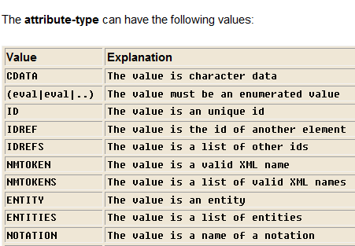
Attribute type

Slide 43
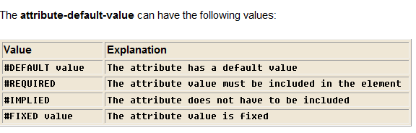
Attribute_default_value

Slide 44
Attribute declaration
DTD example:
<!ELEMENT square EMPTY>
<!ATTLIST square width CDATA "0">
XML example:
<square width=“100"></square>
In the above example the element square is defined to be an empty element with the attributes width of type CDATA. The width attribute has a default value of 0.

Slide 45
Attribute type is default
Syntax: <!ATTLIST element-name attribute-name CDATA "default-value">
DTD example:
<!ATTLIST payment type CDATA "check">
XML example: <payment type="check">

Slide 46
Attribute type implied
Syntax: <!ATTLIST element-name attribute-name attribute-type #IMPLIED>
DTD example:
<!ATTLIST contact fax CDATA #IMPLIED>
XML example:
<contact fax="555-667788 ">
an implied attribute if you don't want to force the author to include an attribute and you don't have an option for a default value either.

Slide 47
Required attribute
Syntax:
<!ATTLIST element-name attribute_name attribute-type #REQUIRED>
DTD example:
<!ATTLIST person number CDATA #REQUIRED> XML example:
<person number="5677">
Use a required attribute if you don't have an option for a default value, but still want to force the attribute to be present.

Slide 48
Fixed attribute
Syntax:
<!ATTLIST element-name attribute-name attribute-type #FIXED "value">
DTD example:
<!ATTLIST sender company CDATA #FIXED "Microsoft">
XML example:
<sender company="Microsoft">
Use a fixed attribute value when you want an attribute to have a fixed value without allowing the author to change it. If an author includes another value, the XML parser will return an error.

Slide 49
Enumerated attributes
Syntax:
<!ATTLIST element-name attribute-name (eval|eval|..) default-value>
DTD example:
<!ATTLIST payment type (check|cash) "cash"> XML example:
<payment type="check"> or
<payment type="cash">
Use enumerated attribute values when you want the attribute values to be one of a fixed set of legal values.

Slide 50
Refer ex4.xml

Slide 51
DTD entities
Entities as variables used to define shortcuts to common text.
Entity references are references to entities.
Entities can be declared internal.
Entities can be declared external

Slide 52
Internal entity declaration
Syntax:
<!ENTITY entity-name "entity-value">
DTD Example:
<!ENTITY writer "Jan Egil Refsnes.">
<!ENTITY copyright "Copyright XML101.">
XML example:
<author>&writer;&copyright;</author>

Slide 53
Internal parsed entity
Refer ex5.xml

Slide 54
DTD for Entity Declaration
//Internal DTD
<?xml version="1.0" encoding="UTF-8"?> <!DOCTYPE note [ <!ENTITY nbsp "&#xA0;"> <!ENTITY writer "Writer: Donald Duck."> <!ENTITY copyright "Copyright: W3Schools."> ]> <note> <to>Tove</to> <from>Jani</from> <heading>Reminder</heading> <body>Don't forget me this weekend!</body> <footer>&writer;&nbsp;&copyright;</footer> </note>
Refer: one.xml

Slide 55
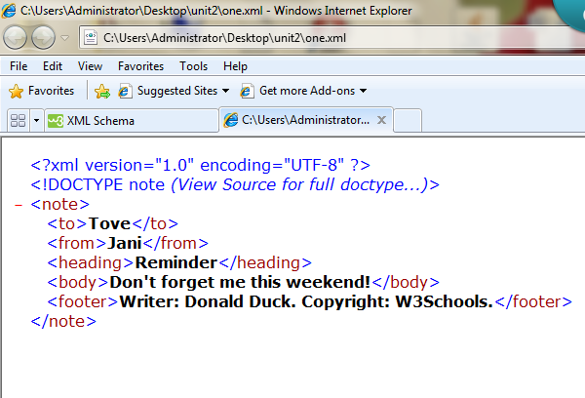

Slide 56
XML namespaces – resolves naming conflicts
<root> <h:table xmlns:h="http://www.w3.org/TR/html4/"> <h:tr> <h:td>Apples</h:td> <h:td>Bananas</h:td> </h:tr> </h:table> <f:table xmlns:f="http://www.w3schools.com/furniture"> <f:name>African Coffee Table</f:name> <f:width>80</f:width> <f:length>120</f:length> </f:table> </root>

Slide 57
Second way:
<root xmlns:h="http://www.w3.org/TR/html4/" xmlns:f="http://www.w3schools.com/furniture"> <h:table> <h:tr> <h:td>Apples</h:td> <h:td>Bananas</h:td> </h:tr> </h:table> <f:table> <f:name>African Coffee Table</f:name> <f:width>80</f:width> <f:length>120</f:length> </f:table> </root>

Slide 58
Third way: //default namespaces
<root>
<table xmlns="http://www.w3.org/TR/html4/"> <tr> <td>Apples</td> <td>Bananas</td> </tr> </table>
<table xmlns="http://www.w3schools.com/furniture"> <name>African Coffee Table</name> <width>80</width> <length>120</length> </table>
</root>

Slide 59
XML Schema
XML Schema defines order of XML element document and its datatype.
MS has developed a language for defining the schema of an XML document called XSD – XML Schema Definition Language

Slide 60
Advantages of XSD over DTD
XSD provides more control over the data
DTD does not allow you to create custom datatypes. XSD allows you to create your own datatype
XSD allows you to specify restrictions on data (content of an element is a positive integer)
The syntax of DTD is not like syntax of XML document while XSD has the syntax of XML document

Slide 61
Support for XML-Schema in various parsers
Sun Multi-Schema XML validator – java tool
MSXML - MS

Slide 62
Types of datatypes
Primitive – fundamental datatypes
Derived – derived from base datatypes
Atomic
List
Union

Slide 63
Primitive datatype
string
decimal
float
boolean
timeDuration
recurringDuration

Slide 64
Derived datatypes
Derived datatype | Base datatype
integer | decimal
long | integer
nonNegetiveInteger | integer
positiveInteger | nonNegetiveInteger
int | long
time | recurringDuration
date | timeDuration

Slide 65
Atomic datatypes – datatypes that cannot be broken down into smaller types (string)
List dataypes – are derived datatypes that are containing a set of values of an atomic datatype.
Ex: pointlist is derived from decimal that contains only decimal values (ex imagine like arrays)
Union datatypes - derived from atomic and list datatypes.
Ex: zipname(atomic type string), zipnum(list of zipcode numbers (int))
Create a dataype called as zips that has both zipname and zipcode.
If you create an element called <zip> of type zips it can take both values:
<zip>chennai<zip>
<zip>12345</zip>

Slide 66
Creation of custom datatype in XSD
Simple type – A datatype that contains only values
Complex type – A datatype that contains child elements, attributes or mixed content

Slide 67
Declaring a simple type element
<xsd:element name=“elementname” type=“datatype” default=“defaultvalue” minOccurs=“nonNegetiveInteger” maxOccurs=“nonNegetiveInteger | unbounded” />
Optional:
minOccurs – 0 (optional) otherwise mandatory
maxOccurs – unbounded – element can occur any number of times

Slide 68
<productdata>
<product productid="P001" category="books">
<productname> gone with the wind </productname>
<description> American civil war</description>
<price>25.00</price>
<quantity>35</quantity>
</product>
</productdata>

Slide 69
Schema specification – simple element
<xsd:element name=“productname” type=“xsd:string”/>
<xsd:element name=“description” type=“xsd:string”/>
<xsd:element name=“price” type=“xsd:positiveInteger”/>
<xsd:element name=“quantity” type=“xsd:nonNegetiveInteger”/>

Slide 70
A simple type can be created from existing types
//You can specify restriction on elements by defining a new simple type from an existing simple type
<xsd:simpleType name=“phoneno”>
<xsd:restriction base=“xsd:string”>
<xsd:length value=“8”/>
<xsd:pattern value=“\d{3}-\d{4}”/>
<xsd:restriction>
<xsd:simpleType>
//facets are various properties of a datatype that can be customized to create a new datatype
//They determine what value can be assigned to a simpletype
//Ex String type has facet: length

Slide 71
Above ex:
Length and pattern are facets
\d – represents digits
{} – specify number of digits that can occur in a an expression

Slide 72
Facets - String
Facets | Description
length | No.of charecters the datatype should contain - nonNegetiveInteger
minLength | nonNegetiveInteger
maxLength | nonNegetiveInteger
pattern | Regular expression the datatype should match
enumeration | Set of values a datatype can contain

Slide 73
Facets for numeric values
<xsd:simpleType name =“num”>
<xsd:restriction base=“xsd:positiveInteger”>
<xsd:maxInclusive value=“400”/>
<xsd:minInclusive value=“10”/>
<xsd:restriction>
</xsd:simpleType>

Slide 74
Associating an element with a simple type
<xsd:element name=“empname” type=“xsd:string”/>
<xsd:element name=“empaddress” type=“xsd:string”/>
<xsd:element name=“empphone” type=“phoneno”/> …….refer to slide 70

Slide 75
Schema specification – simple element
<xsd:element name=“productname” type=“xsd:string”/>
<xsd:element name=“description” type=“xsd:string”/>
<xsd:element name=“price” type=“xsd:positiveInteger”/>
<xsd:element name=“quantity” type=“xsd:nonNegetiveInteger”/>

Slide 76
Declaring complex element
<xsd:complexType name=“complex datatype name”>
………
</xsd:complexType>

Slide 77
Ex (first way)
<xsd:complexType name=“prdt”>
<xsd:sequence> // sequence in which elements must appear inside product
<xsd:element name=“productname” type=“xsd:string”/>
<xsd:element name=“description” type=“xsd:string”/>
<xsd:element name=“price” type=“xsd:positiveInteger”/>
<xsd:element name=“quantity” type=“xsd:nonNegetiveInteger”/>
</xsd:sequence>
</xsd:complexType>

Slide 78
Prdt – is named datatype

Slide 79
<xsd:element name=“product”/> (second way)
<xsd:complexType >
<xsd:sequence> // sequence in which elements must appear inside product
<xsd:element name=“productname” type=“xsd:string”/>
<xsd:element name=“description” type=“xsd:string”/>
<xsd:element name=“price” type=“xsd:positiveInteger”/>
<xsd:element name=“quantity” type=“xsd:nonNegetiveInteger”/>
</xsd:sequence>
</xsd:complexType>
……anonymous datatypes – child elements not referenced by common name

Slide 80
Create an XML Schema – The schema element
<xsd:schema xmlns:xsd=“http://www.w3.org/2001/XMLSchema”>
<xsd:element name=“productdata” type=“prdata”/>
<xsd:complexType name=“prdata”>
<xsd:sequence>
<xsd:element name=“product” type=“prdt” maxOccurs=“unbounded” />
</xsd:sequence>
</xsd:complexType>

Slide 81
<xsd:complexType name=“prdt”>
<xsd:sequence>
<xsd:element name=“productname” type=“xsd:string”/>
<xsd:element name=“description” type=“xsd:string”/>
<xsd:element name=“price” type=“xsd:positiveInteger” />
<xsd:element name=“quantity” type=“nonNegetiveInteger”/>
</xsd:sequence>
</xsd:complexType>
</xsd:schema> …………….refer product.xsd

Slide 82
p1.xml
<?xml version="1.0" encoding="UTF-8"?>
<productdata xmlns:xsi="http://www.w3.org/2001/XMLSchema-instance" xsi:noNamespaceSchemaLocation="product.xsd">
<product>
<productname>pen</productname>
<description>flair</description>
<price>200</price>
<quantity>12</quantity>
</product>
</productdata> ………..create xml file in xmlspy and browse through the schema file(product.xsd)…it adds the xsi prefix

Slide 83
Declaring attributes in XML-Schema
<attribute name=“attributename” default=“defaultvalue” fixed=“fixedvalue” ref=“attributename” type=“datatypename” use=“value”/>
Optional:
default, fixed (but both cannot occur together),
ref (used to refer a user-defined attribute declared in same or other xsd, you cannot refer and declare an attribute in the same declaration statement), use

Slide 84
use attribute
Optional – specifies that the user-defined attribute in the XML document is not compulsory. Default value of use is optional.
<xsd:attribute name=“price” type=“xsd:integer” use=“optional” />

Slide 85
use attribute
required – Specifies that the attribute must occur in the xml document that conforms to schema. If you do not specify the value for required attribute an error is generated.
<xsd:attribute name=“price” type=“xsd:integer” use=“required” />

Slide 86
Schema file - .xsd extension
<xsd:schema xmlns:xsd=“http://www.w3.org/2001/XMLSchema”>…..explicit declaration
<xsd:element name=“product” type=“prod”/>
<xsd:complexType name=“prod”>
<xsd:sequence>
<xsd:element name=“productname” type=“xsd
:string”/>
<xsd:element name=“description” type=“xsd:string”/>
<xsd:element name=“price” type=“xsd:positiveInteger”/>
<xsd:element name=“quantity” type=“xsd:integer”/>

Slide 87
</xsd:sequence>
<xsd:attribute name=“proid” type=“xsd:string” use=“required”>
</xsd:attribute>
</xsd:complexType>
</xsd:element>

Slide 88
Attributes
Global – attributes declared outside all element declarations, reusability
<xsd:schema>
<xsd:attribute name=“name” type=“xsd:string”/>
</xsd:schema>

Slide 89
<xsd:element name=“book” type=“booktype”/>
<xsd:complexType name=“booktype”>
……
<xsd:attribute ref=“name” />
…..
</xsd:complexType>
<xsd:element name=“author” type=“authortype”/>
<xsd:complexType name=“authortype”>
…
<xsd:attribute ref=“name” />
…
</xsd:complexType>

Slide 90
Global attribute declaration cannot include the use attribute.
This is b’cos the global attribute declaration cannot specify the way in which the attribute must be used in the XML document.
The use attribute can only be specified while referencing the global attribute from some other place.
Global attributes can be referenced with both simple and complex type.

Slide 91
Global Vs local attributes
Global:
<xs:schema xmlns:xs="http://www.w3.org/2001/XMLSchema" xmlns="http://datypic.com/prod" targetNamespace="http://datypic.com/prod"> <xs:attribute name="system" type="xs:string"/> <xs:attribute name="dim" type="xs:integer"/> <xs:complexType name="SizeType">
<xs:attribute ref="system" use="required"/> <xs:attribute ref="dim"/>
</xs:complexType> </xs:schema>

Slide 92
Local attributes:
<xs:schema xmlns:xs="http://www.w3.org/2001/XMLSchema" xmlns="http://datypic.com/prod" targetNamespace="http://datypic.com/prod"> <xs:complexType name="SizeType">
<xs:attribute name="system" type="xs:string" use="required"/>
<xs:attribute name="dim" type="xs:integer"/> </xs:complexType>
</xs:schema>

Slide 93
Restricting the values assigned to an attribute
<xsd:attribute name=“proid” type=“pid” use=“required”/>
<xsd:simpleType name=“pid” >
<xsd:restriction base=“xsd:string”>
<xsd:pattern value=“[p]{1}\d{3}”/>
</xsd:restriction>
</xsd:simpleType>

Slide 94
Declaration of elements and attributes – x1.xsd
Refer x1.xsd
Refer p3.xml

Slide 95
Qualified and unqualified attributes
The declaration of a target namespace gives us the possibility of defining elements and attributes that belong to the target namespace (called "qualified") and elements and attributes that don't belong to any namespace (called "unqualified").

Slide 96
Using components of one schema in another
Apply restrictions across multiple documents
The include element:
This element is used to include or reference an external schema that is located at a definite address.
<include id=“ID” schemaLocation=“filename”/>
Id attribute specify the ID of the element which is unique in the XSD document
schemaLocation – physical location of the schema

Slide 97
The include element can have multiple occurrences in the in an xsd.
The schema element is the parent element of the include element.
The restriction placed on include element is both containing and contained schema files must belong to the same targetnamespace.
The targetnamespace has a reference to a URI to which the schema belongs
The include element allows to reference external schema which is defined in the context of the same namespace.
The target namespace for the schema is declared using the targetNamespace attribute of schema element.

Slide 98
Example schema file
<schema xmlns=http://www.w3.org/2001/XMLSchema targetNamespace=www.abc.com/purchase> …..default declaration
<simpleType name=“prstring” >
<restriction base=“string”>
<pattern value=“[p]{1}\d{3}”/>
</restriction>
</simpleType>
</schema>

Slide 99
Reusing schema
<schema xmlns=http://www.w3.org/2001/XMLSChema targetNamespace=www.abc.com/purchase xmlns:prd=www.abc.com/purchase>
<include schemaLocation=“potype.xsd”/>
….
<element name=“proid” type=“prd:prstring”/>
….
</schema>

Slide 100
Default namespace – http://www.w3.org/2001/XMLSchema
Targetnamespace – www.abc.com/purchase
In both schemas the targetNamespace is the same
Prefix prd is used as an alias to refer to the namespace URI - www.abc.com/purchase
You can refer to the datatypes declared in potype.xsd by using prd prefix before the name of the datatype
If we do not use prd then prstring will be considered to belong to default namespace

Slide 101
import element
Import is similar to include but allows access to components from multiple schemas belonging to different target namespace.
<import id=“ID” namespace=“namespace” schemaLocation=“filename”/>
Namespace specify – URI and associated prefix

Slide 102
example
Refer potype.xsd
Refer purchaseorder.xsd
Refer purchase.xml

Slide 103
Grouping elements and attributes in an XML Schema
Grouping attributes and elements in schema:
sequence
group (element)
choice
all
attributeGroup (attributes)

Slide 104
sequence element
Refer s1.xsd
Refer x1.xml
Sequence checks the order of child elements within the parent element

Slide 105
group element
Set of elements can be grouped together by a common name incorporated into a complex datatype.
By grouping we can refer to a set of related elements by a common name.
<group maxOccurs=“nonNegetiveInteger|unbounded” minOccurs=“nonNegetiveInteger” name=“groupname” ref=“Qname”></group>

Slide 106
maxOccurs – maximum number of times a group can occur in an XML document
minOccurs – minimum number of times a group can occur in XML document
name – name of the group
ref – refer to a group in a complex type element
Refer g1.xsd
Refer x2.xml

Slide 107
choice element
Alternative options can be specified with choice.
<choice id=“ID” maxOccurs=“nonNegativeInteger|unbounded” minOccurs=“nonNegativeInteger”></choice>
Refer c1.xsd
Refer x3.xml (replace residence element by office element for choice)

Slide 108
all element
The all element enables you to use the child elements in any order as against the sequence element, which specifies the order in which the child element should appear.
<all maxOccurs=“positiveInteger” minOccurs=“0/1”></all>
Refer a1.xsd
Refer x4.xml (the order can only change..but we cannot omit child elements)

Slide 109
attributeGroup element
Attributes can be grouped so that it can be reused by different elements.
<attributeGroup name=“groupname”>
Attribute1
Attribute2
……
</attributeGroup>
Refer:ag1.xsd
Refer:x5.xml (show adding the attributes in x5.xml in xmlspy)

Slide 110
XML presentation technologies
Data is stored in XML document by using elements and attributes.
XML focus on data storage not presentation of data.
Rendering refers to the act of processing XML documents so that it can be displayed on a variety of targets, such as web browsers, email pagers, and cell phones.
XML presentation technologies provide a modular way to deliver and display content to a variety of devices.
Here we examine some technologies for display, including CSS and XSL.

Slide 111
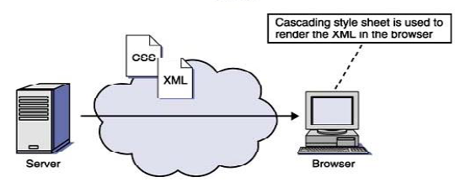
CSS
Cascading style sheets is an XML-supporting technology for adding style display properties such as fonts, colors, or spacing to Web documents.

Slide 112
Refer recipe.xml and recipe.css

Slide 113
XSL – extended style language
XSL 1.0 is a W3C Recommendation that provides users with the ability to describe how XML data and documents are to be formatted.
XSL does this by defining "formatting objects," such as footnotes, headers, or columns.

Slide 114
An XSL style sheet is basically a series of pattern-action rules and looks like an XML document with a mixture of two kinds of elements:
those defined by XSL and
those defined by the object language.
The action part of the rule is called the "template" in XSL, and a template and a pattern together are referred to as a "template rule."

Slide 115
The result of applying all matching patterns to a document recursively is a tree of objects, which is then interpreted top-down according to the definition of each object.
For example, if they are HTML objects, an HTML document will be generated; if they are XML objects, XML will be the result.

Slide 116
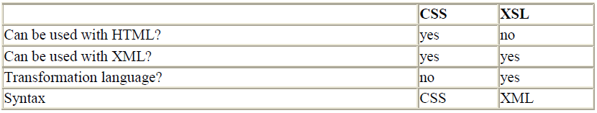
Comparison of XSL and CSS

Slide 117
The general principle is that if the document is to be simply rendered and not transformed in any way through the addition or deletion of items, then CSS is the more straightforward approach.
Refer places.xml and place.xsl

Slide 118
XML transformation
The transformation language lets you transform the structure of documents into different forms (such as PDF, WML, HTML, or another schema type), while the formatting language actually formats and styles documents in various ways.
In practice, you often transform a document before formatting it.

Slide 119
XSL is made up of the following parts:
XSL Transformation (XSLT): It is an XML based language that allows to transform an XML document into another XML document.
XMLPath (XPath): It is a language that is used to access different parts of an XML document, such as elements and attributes.
XSL formatting objects (XSL-FO), which specify how the data is to be displayed.

Slide 120
Transformation of documents can be done in 3 ways:
On the server— A server program, such as a Java servlet or a JavaServer Page (JSP), can use a stylesheet to transform a document automatically and serve it to the client.
On the client— A client program, such as a browser, can perform the transformation, reading in the stylesheet that you specify with the <?xml-stylesheet?> processing instruction. Internet Explorer can handle transformations this way, to some extent.
With a separate program —Several standalone programs, usually based on Java, will perform XSLT transformations.

Slide 121
XSLT
To perform an XSL transformation, a program referred to as an XSLT processor reads both an XML document and an XSLT document that defines how to transform the XML .
An XSLT processor has the capability to read the XML source document, and rearrange and reassemble it in a variety of ways, even adding new text and tags.

Slide 122
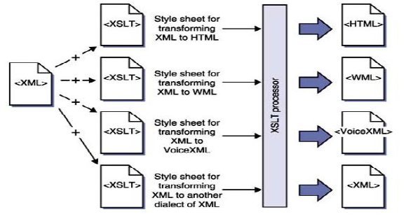

Slide 123
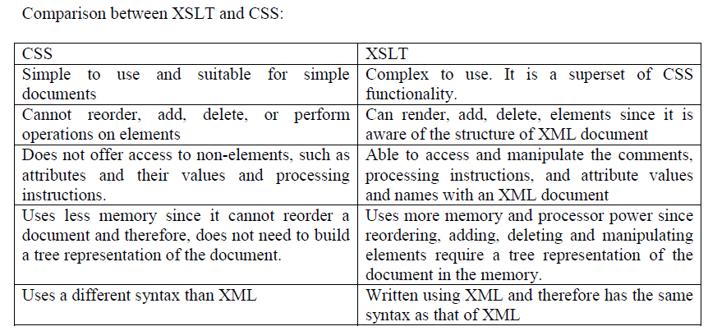

Slide 124
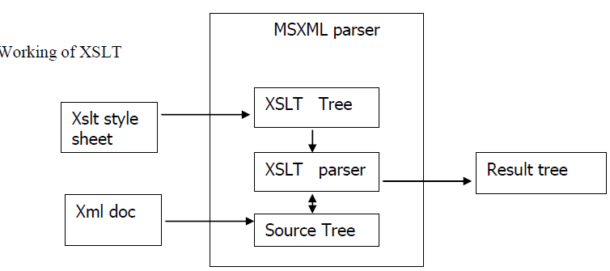

Slide 125
The XSLT processor comes packaged along with MSXML parser.
Since XSLT is an application of XML, the MSXML parser is also used to parse an XSLT document.
The MSXML parser parses the XSLT stylesheet and creates a tree structure based on the elements and attributes used in an XSLT document.
This tree is referred to as the XSLT tree.

Slide 126
The XSLT processor component of the MSXML parser takes the transformation information contained in the XSLT stylesheet, applies it to the data retrieved from the source document, and builds a resultant tree structure referred to as the result tree.
This tree is then rendered to various targets, such as web browsers, pagers, and cell phones.

Slide 127
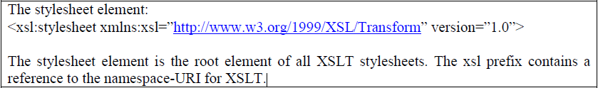
XSLT elements to select and format the data

Slide 128
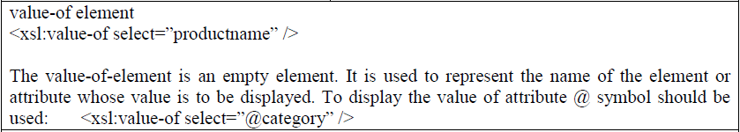

Slide 129
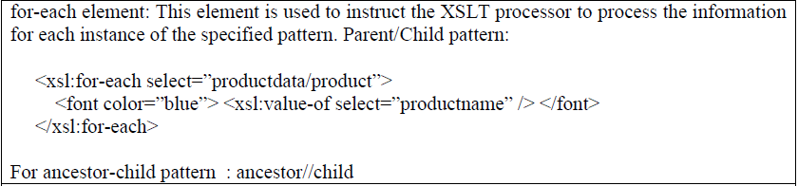

Slide 131
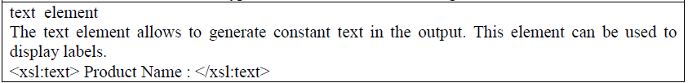

Slide 132
XSLT template rules
A template rule describes how an XML element and its contents are converted into a format that can be displayed in the browser. A template rule consists of two parts:
A pattern that identifies an XML element in an XML document
An action or processing code that details the transformation and rendering of the resulting element.

Slide 133
The template element: It is used to define a template for desired output. The syntax is as follows:
<xsl:template match=‖pattern‖>
[action to be taken]
</xsl:template>

Slide 134
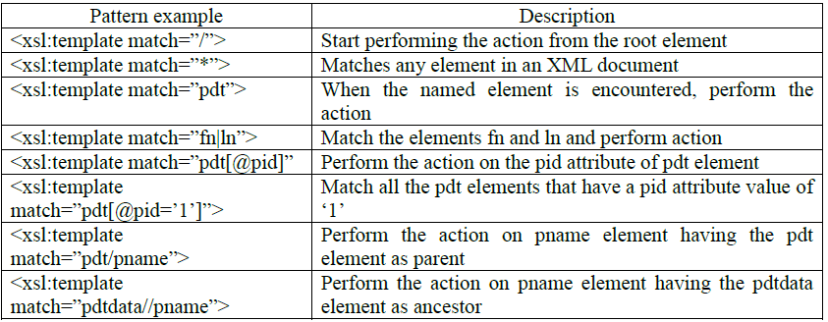

Slide 135
The apply-templates elements :
This element is used to instruct the XSLT processor to find an appropriate template and perform the specified tasks on each selected element. The syntax for using this element is as follows:
<xsl:apply-templates [select=‖pattern‖]>

Slide 136
The select attribute is optional and is used to specify the context in which the template should be executed. The default value for this attribute is ―node()‖, which means that the template should be executed for the children of the current node.

Slide 137
Examples
Refer a.xml and a.xsl
Refer b.xml and b.xsl
Refer c.xml and c.xsl

Slide 138
If statement
Refer d.xml and d.xsl

Slide 139
When..choose statements
Refer e.xml and e.xsl

Slide 140
Various comparison and boolean operators:

